Slide 1







Draft Bank Customised Product
for
Agri & Allied Sector
for
Priority Sector Lending (PSL)
predominated by
Organised Small & Marginal Farmers
Bank Product
Bank Product
Presented by
Associated Tea & Agro Management Services Pvt. Ltd., Guwahati

Slide 2
Present Status of Huge Agri & Allied Sector Predominated by Organised Small & Marginal Farmers
Possible to Create Bank Linkage
Difficult to Create Bank Linkage
Organized
Agri & Allied Sector
35% of total small & marginal farmers of Assam has been organised and developed by GoA in last 10 years mostly in the form of FPOs
Remaining 65 % remain Unorganised with Huge accumulated Liability as NPA which is compounding every year.
Cluster based MSE Sector
25 – 30 thousand (Approx.)
Micro Food Processing &
Small Business Entrepreneurs
Approx. 20 Lakh Hectare Land Area predominated by Approx. 25 Lakh Small & Marginal Farmer

Slide 3
CLUSTER CONCEPT
Clusters are geographic concentrations of Farmers that produce/manufacture same/similar products. A Cluster Concept teaches the farmers to analyze their existing cultivation/MSME bases and build their economic development on those strengths. The next step is to develop a marketing plan for farmers produces/industry.
A strong cluster will include the suppliers of raw materials (Catchment area development) and the distributors, as well as the primary producers. It may be difficult to predict where clusters will emerge beforehand, but their growth is easier to predict due to the benefits gained from the strategy.
A well developed concentration of related business spurs three important activities: increased productivity (through specialized inputs, access to information, synergies, and access to public goods), more rapid innovation (through cooperative research and competitive striving), and new business formation (filling in niches and expanding the boundaries of the cluster map). AND, Clusters are always dynamic- keep changing
Based on opportunities and benefits of Clustering, Govt. of India mooted the idea of formation of FPCs/FPOs, etc. with legal identities to provide leverage, especially to the small and marginal farmers and invested heavily to provide them hand holding supports, capacity building and the like.

Slide 4
Modus Operandi for availing Credit and its Undisputable Utilization
FPC prepares the Detailed Project Report having Technical Viability and Economically Feasible
FPC Submits the Report to the Bank with all the required genuine documents, as applicable with the Bank
Bank after appraisal of the DPR and scrutiny of the documents, if found viable releases the Cash Credit with the approved limit to the FPC
FPC identifies the Vendors capable of supplying seeds/fertilizers/manures, etc. along with the Bank
Then places them the Work Order for supply of the items and quantity wise
Vendors supply the quality materials within schedule to the FPC
FPC in turn distributes these materials to the FIGs as per their requirement as assessed earlier. The Lead Farmer of the FIG then distributes to the farmers. A proper receipt (in triplicate) against supply to each farmer will be maintained by the Lead Farmers, a copy of which will be given to the FPC, another copy will be maintained by the Lead Farmer and the third copy will be kept by the individual farmers. Similarly, the receipts will be maintained by both FPC and the Lead Farmer while supplying the materials to each FIG
The services of the Professional Service Providers will be pressed into action for capacity building, extension services, etc.
The farmers will start cultivating with intensive management for commercial production under supervision of experts
After harvesting, the produced goods will be supplied to the FPC who in turn will sell in the market
The sale proceeds will be deposited in the bank by the buyers directly

Slide 5
Modus Operandi - continued
The Bank after deducting the interest, principal amount will release the balance amount to the FPC
FPC will deduct their commission and other committed expenses and release the agreed amount as per the Legal Agreement to the Farmers
FPC will also release the agreed amount as per the Legal Agreement to the Professional Service Providers.
This Cycle will continue for the next season of cultivation
N.B. There will be Legal agreements between the FPC and the FIGs/Farmers against supply of materials for carrying out the cultivation, farm gate price of the buyback products from the farmers by FPC, Legal Agreements with the Professional Service Providers, etc. a copy of which will be deposited with the bank also.

Slide 6
FLOW CHART OF PROJECT MANAGEMENT INVOLVING THE PMU
Rejected
BANK BRANCH
Submit DPR
FPC
Sanctioned
No
Financial Limit
Yes
Customer Verification, Documentation
Higher Level
No
Yes
PMU
No
Techno-Economic Feasibility
Yes
Project recommended

Slide 7
Relationship
FIG and FPC | Farmers are registered members/shareholders of the FPC and are again organized in 20-25 nos. under a Farmers Interested group (FIG) being headed by a Lead farmer. They have legal agreement to receive all assistance from FPC including raising of funds and in lieu deliver all their agricultural produce after harvest to the concerned FPC for Marketing as forward linkage.
FPC and Bank | FPCs, when required as per their BOD minutes, approaches banks to raise Loan for funding their activity. The funds so raised are undisputedly incurred for the purpose it was meant and repay to the bank after the produced goods are sold. In other sense, FPC and Bank’s operational relationship is purely conventional banking relationship like any corporate and bank

Slide 8
Diagrammatic Representations
Funding to FPO – Plantation / Cultivation - Paddy, Mustard, Maize, etc.
Funding to FPO – Agri Infra – Mini Rice Mill
Funding to FPO – Agri Infra – Silo
Funding to FPO – Agri Infra – Warehouse
Funding to FFPO – Pisciculture
Funding to FFPO – Fish Cold Storage
Funding to FPO – Dairy Processing
Funding to FPO – Poultry
Funding to FPO – Goatery
Funding to FPO – Entire Value Chain – Cultivation, Processing & Packaging, Market
Funding to cluster - Schematic & Non-schematic loan for a Piggery value chain
Funding to MSE – Cluster Based

Slide 9
Funding to FPO – Plantation / Cultivation
(Paddy, Mustard, Maize, etc.)
FUND FLOW AND ITS UTILIZATION
RECOVERY OF THE LOAN COMPONENT
Vendors
BANK
Vendors
BANK
5
3
3
2
1
4
4
FIG
FIG
FIG
FIG
FIG
6
FPC
FIG
FIG
FIG
FPC
Market
1
2
FIG
FIG
Proposal submission
Proposal Acceptance and release Cash Credit to FPC
Work Order to Vendor
Supply by Vendors to FPC
Payment to Vendors by FPC
FPS distributes to FIGs
FIGs Supply the harvested stock to FPC
FPC sells the stock in the Market
The Sale proceeds are directly deposited with the bank by buyers
Bank after deducting the Interest, Principal, releases the balance to the FPC
FPC after deducting their commissions/committed payments, release the agreed amount to Farmers, Service Providers
Professional Service Providers
Professional Service Providers
Diagrammatic representation

Slide 10
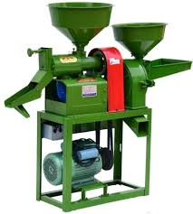
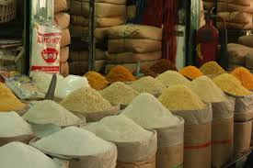
Funding to FPO – Agri Infra
Back Ended Subsidy
FPO
Bank
Sale Proceeds
1
7
Loan for Agricultural/Horticultural Value Addition,
e.g. Rice Mill
Working capital
Term Loan
5
Sanction of Term Loan & Working capital
Construction of Shed, etc.
Money Transferred to equipment Vendors by Bank
Procurement of Paddy from Working Capital
Milling
Selling of Rice in Market
Sales Proceeds directly to bank by buyers
3
4
Paddy
6
FPC
Rice
2
Supply Materials
Modern Mini Rice Mill
Market
Forward Integration
Vendors
SECURITY OF THE LOAN:
Business Security
Primary Security
CGTMSE up to Rs. 200 Lakhs
(Wherever applicable)

Slide 11

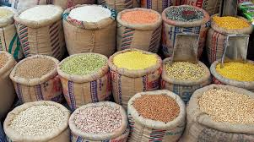
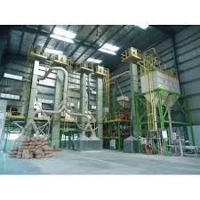
Funding to FPO – Agri Infra
Interest Subvention
FPO
Bank
Sale Proceeds
Loan (Under AIF) for Storage Silo, e.g. Maize/Mustard
1
7
Working capital
Term Loan
Sanction of Term Loan & Working capital
Money Transferred to equipment Vendors by Bank
Foundation, Installation of Silo, etc.
Harvest Grains
Storage of Grains in Silo
Selling in Market/Grain Processing Unit
Sales Proceeds directly to bank by buyers
5
2
4
6
Maize
FPC
Maize
3
Supply Materials
Storage Silo
Market/Grain
Processing Unit
Forward Integration
Vendors
SECURITY OF THE LOAN:
Business Security
Primary Security
CGTMSE up to Rs. 200 Lakhs
(Wherever applicable)

Slide 12

Funding to FPO – Agri Infra
Interest Subvention
FPO
Bank
Sale Proceeds
Loan (Under AIF) for Storage Warehousing e.g. Grains/Pulses
1
7
Sanction of Term Loan & Working capital
Money Transferred to equipment Vendors by Bank
Foundation, construction of Warehouse, etc.
Harvest Grains
Storage of Grains in Warehouse
Selling in Market/Grain Processing Unit
Sales Proceeds directly to bank by buyers
Working capital
Term Loan
5
2
4
6
Maize
FPC
Maize
3
Supply Materials
Warehouse Storage
Market/Grain
Processing Unit
Forward Integration
Vendors
SECURITY OF THE LOAN:
Business Security
Primary Security
CGTMSE up to Rs. 200 Lakhs
(Wherever applicable)

Slide 13
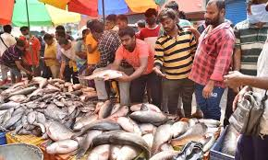

Funding to FFPO – Pisciculture
Back Ended Subsidy
FPO
Bank
Sale Proceeds
Loan for Fishery
1
7
Sanction of Term Loan & Working capital
Money Transferred to equipment Vendors by Bank
Pond digging, Infrastructure, etc.
Procure Fries/fishes
Fish Rearing
Selling in Market
Sales Proceeds directly to bank by buyers
Working capital
Term Loan
5
2
4
6
FPC
Fries/Fish
Fish
s
3
Supply Materials
Fishery
Market
Forward Integration
Vendors
SECURITY OF THE LOAN:
Business Security
Primary Security
CGTMSE up to Rs. 200 Lakhs
(Wherever applicable)

Slide 14
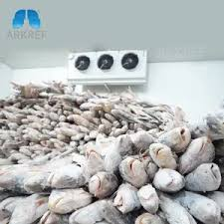
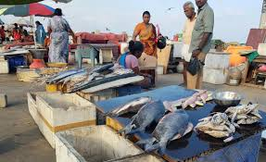
Funding to FFPO
Back Ended Subsidy
FPO
Bank
Sale Proceeds
Loan for Fish Storage
1
7
Working capital
Sanction of Term Loan & Working capital
Money Transferred to equipment Vendors by Bank
Construction of Cold Storage, etc.
Procurement of Raw Fish from Working Capital
Processing
Selling in Market
Sales Proceeds directly to bank by buyers
Term Loan
5
2
4
6
Fish
Fish
FPC
3
Supply Materials
Fish Cold Storage
Market
Forward Integration
Vendors
SECURITY OF THE LOAN:
Business Security
Primary Security
CGTMSE up to Rs. 200 Lakhs
(Wherever applicable)

Slide 15

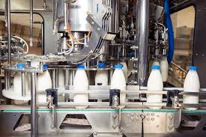
Funding to FPO - Dairy
Back Ended Subsidy
FPO
Bank
Sale Proceeds
Loan for Dairy Processing
1
7
Sanction of Term Loan & Working capital
Money Transferred to equipment Vendors by Bank
Foundation, Installation of Machinery, etc.
Procure Milk
Dairy Processing
Selling in Market
Sales Proceeds directly to bank by buyers
Working capital
Term Loan
5
2
4
6
Milk
Dairy
FPC
Products
3
Supply Materials
Dairy Processing
Market
Forward Integration
Vendors
SECURITY OF THE LOAN:
Business Security
Primary Security
CGTMSE up to Rs. 200 Lakhs
(Wherever applicable)
N.B.: A model can be developed based on requirement

Slide 16
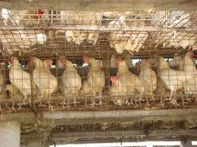
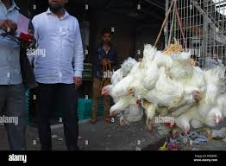

Funding to FPO
Back Ended Subsidy
FPO
Bank
Sale Proceeds
Loan for Poultry
1
7
Sanction of Term Loan & Working capital
Money Transferred to equipment Vendors by Bank
Foundation, Installation of cages, etc.
Procure Chicks
Rearing Chicks for hatching/broiler
Selling in Market
Sales Proceeds directly to bank by buyers
Working capital
Term Loan
5
2
4
6
Chicks
Poultry
FPC
Products
3
Supply Materials
Poultry
Market
Forward Integration
Vendors
SECURITY OF THE LOAN:
Business Security
Primary Security
CGTMSE up to Rs. 200 Lakhs
(Wherever applicable)

Slide 17
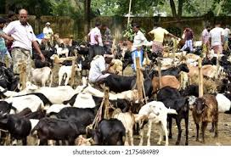
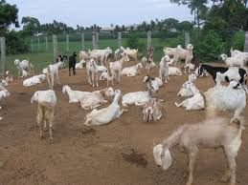
Funding to FPO
Back Ended Subsidy
FPO
Bank
Sale Proceeds
Loan for Goatery
1
7
Sanction of Term Loan & Working capital
Money Transferred to equipment Vendors by Bank
Foundation, Installation of Infrastructure, etc.
Procure Goat Kids
Rearing Goat Kids for Sale as whole
Selling in Market
Sales Proceeds directly to bank by buyers
Working capital
Term Loan
5
2
4
6
Kids
Milk
FPC
Meat
3
Supply Materials
Goatery
Market
Forward Integration
Vendors
SECURITY OF THE LOAN:
Business Security
Primary Security
CGTMSE up to Rs. 200 Lakhs
(Wherever applicable)

Slide 18

Funding to FPO – Entire Value Chain – Cultivation, Processing & Packaging, Market
SECURITY OF THE LOAN:
Business Security
Primary Security
CGTMSE up to Rs. 200 Lakhs
(Wherever applicable)
BANK
Vendors
STEPS:
Proposal from FPC to Bank
Bank Release Working Capital based on Appraisal results
FPC places Work Order to Vendor for Supply of Planting Materials, fertilizers, etc.
Vendor Supplies the Materials to FPC
FPC distributes the same amongst Farmers
Farmers disburses the harvested products to FPC
FPC sells these good in the Market
The Sale Proceeds are deposited to the bank by the buyers
Bank after deducting interest, principal amount, credits the balance to the FPC
FPC then deducting their commission, etc. disburses the agreed amount to the Professional Service Providers
FPC also credits the agreed amount to the Farmers
9
8
3
2
1
4
11
FIG
6
FIG
FIG
FIG
5
FPC
MARKET
7
FIG
10
Backward integration
Forward integration
Professional Service Providers

Slide 19


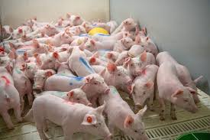
ENTIRE PIGGERY VALUE CHAIN
FUNDING TO CLUSTER - SCHEMATIC LOAN FOR A PIGGERY VALUE CHAIN
NON-SCHEMATIC LOAN-PIGGERY VALUE CHAIN
Bank
Cluster of 8 no. Fattening Units comprising
8 SHGs each consisting 10 members
Contribution-
Rs. 11 Lakh
Cluster of 20 no. Pig Rearers
(1 SHG)
Rs. 15 Lakh
Rs. 35 Lakh
50 Sows
5 Boars
Rs. 40 Lakh
NLM
Project Cost
Rs. 46 Lakh
Project Cost- Rs. 26 Lakh X 8 = Rs. 208 Lakh
Bank
Annual Turnover
Rs. 52 Lakh
Repayment
6 Years (1 Yr Moratorium)
800 Piglets/annum
Rs. 168 lakh (Under KCC to 80 Persons)
Output- 96 MT/annum of Pork
FPC
FPC
Annual Turnover
Rs. 240 Lakh
Repayment
6 Years (1 Yr. Moratorium)
Fattening Cluster
3 Nos. of Mini Feed Mills

Slide 20

Funding to MSE – Cluster Based
Loan Proposal for Cluster based Micro Food Processors (Small Entrepreneurs) with a proper financial projection acceptable by the Bank (DPR).
Loan will be taken by Cluster Based Micro Food Processors.
Raw Material (inputs) to be procured from cluster based farmers from FPO / FPC to feed the Processing Units.
Processing to be done in Cluster by the Micro Food Processors (Small Entrepreneurs) to achieve Economy of Scale.
The Micro Food Processors will contribute 5 – 10 % in the form of Equity under Schematic Priority Sector Lending.
Banks will provide 90 – 95 % Term Loan under Schematic Priority Sector Lending.
As per contract, the Processed and Finished Product will be sent to FPC.
Professional Service Provider will support the Micro Food Processors (Small Entrepreneurs) and FPC in the following areas such as, Accounts and Tax, Legal, IT, Cost, Field operations, Training, Capacity Building, etc.
FPC , after Packaging and Branding will sell the Marketable Product to Buyer.
Modality
Process of Funding Priority Sector Loan (Schematic)
Bank Loan to Cluster through Machinery Suppliers & Construction Vendors
Processing
Forward Linkage
Machinery Suppliers
Processing
In Cluster
Finished
Product
FPC - X
Packaging & Branding Cluster Product
Buyer
Bank
(Term Loan &
Working Capital)
Cluster of Micro & Small Entrepreneur
(10, 20, 30 Units)
In a Block / District
Construction Vendors
Raw Material from
FPC - X
Backward Integration
Cashless Transaction
There will be a tripartite agreement involving the Bank, Cluster Based Micro Food Processors (Small Entrepreneurs) and FPC where Bank will fund the Cluster Based Micro Food Processors (Small Entrepreneurs), they will process the Product and sell to FPC and the FPC will market the Product and after paying the Cluster Based Micro Food Processors (Small Entrepreneurs) and keeping its share, the FPC will repay the Bank.
=

